Slide 1
“Programming Learning Platform
for
School Going Students”
Topics:
Sequence Diagram + Collaboration Diagram
Group-05:
-1805095
-1805096
-1805098
-1805103
-1805105
-1805119
Presented By:
-1805103
-1805119

Slide 2
Sequence
Diagram

Slide 3
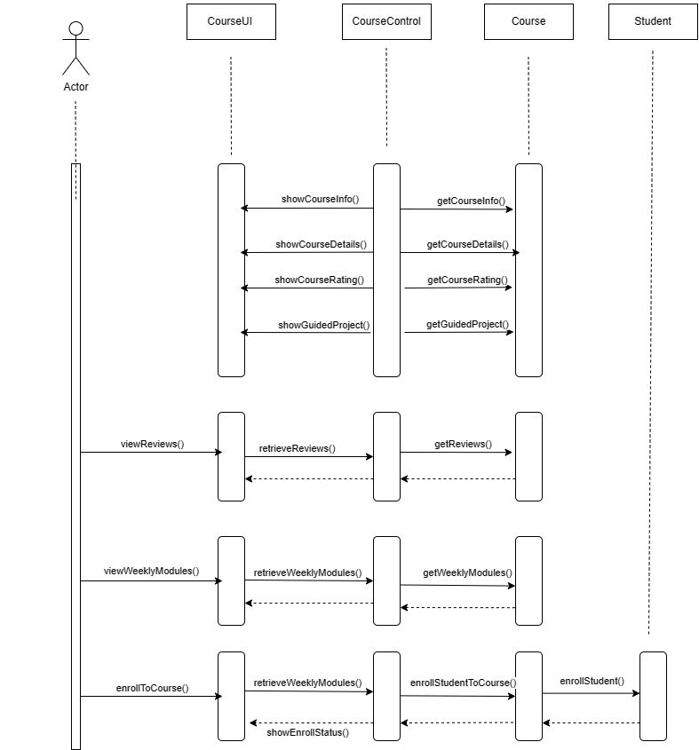
Course Details Page:

Slide 4
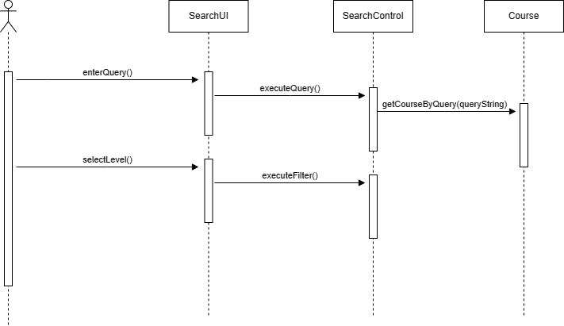
Course Searching:

Slide 5
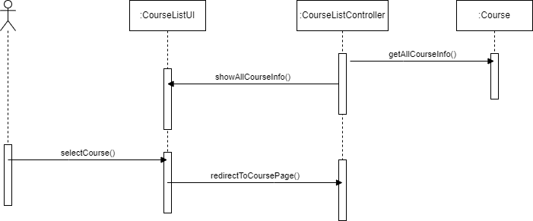
User Dash Board (HomePage):

Slide 6
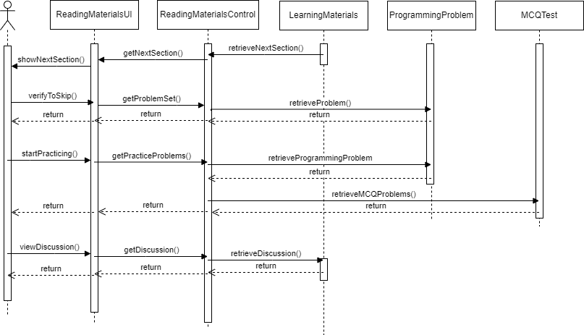
Reading_Materials:

Slide 7
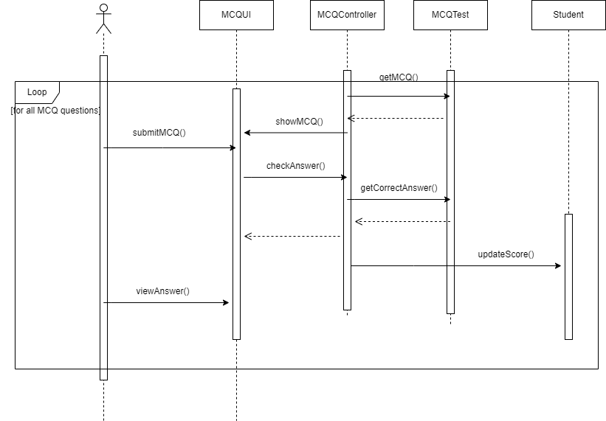
MCQ_Test:

Slide 8
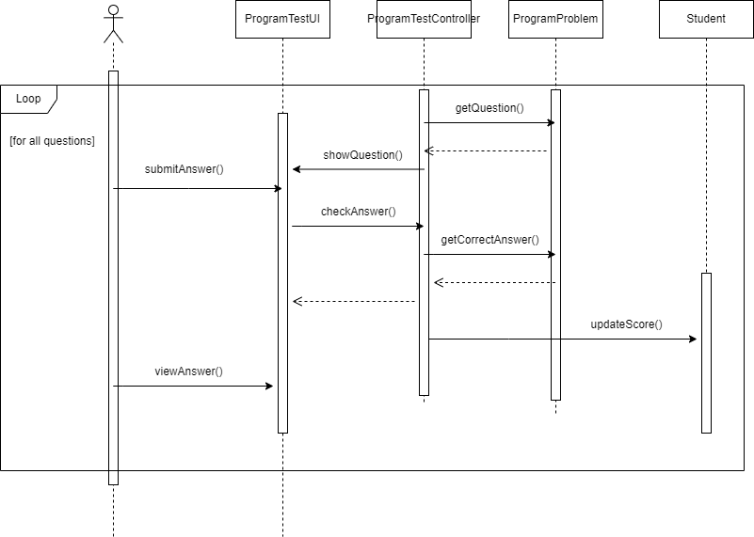
Programming_Problem_Test:

Slide 9
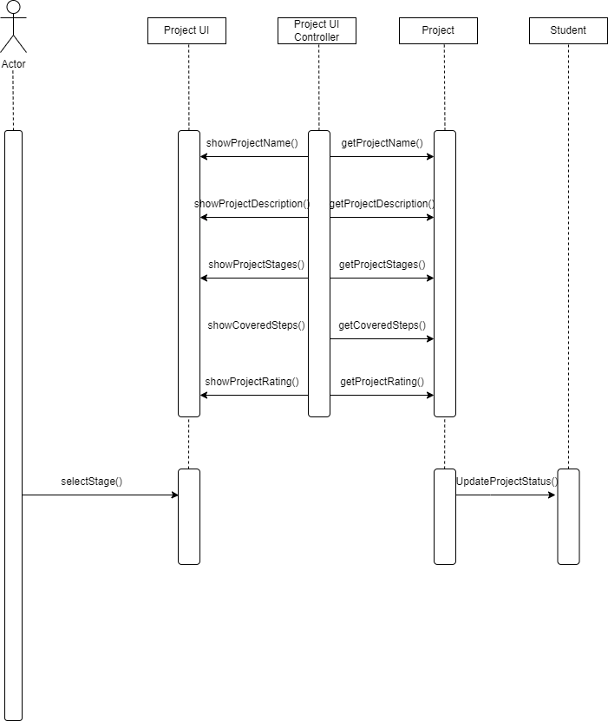
Project

Slide 10
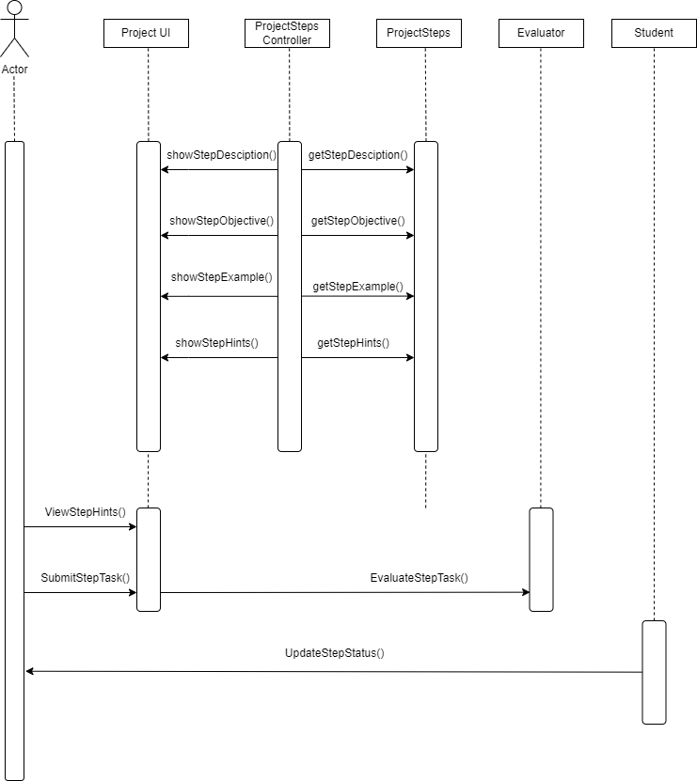
Project Steps

Slide 11
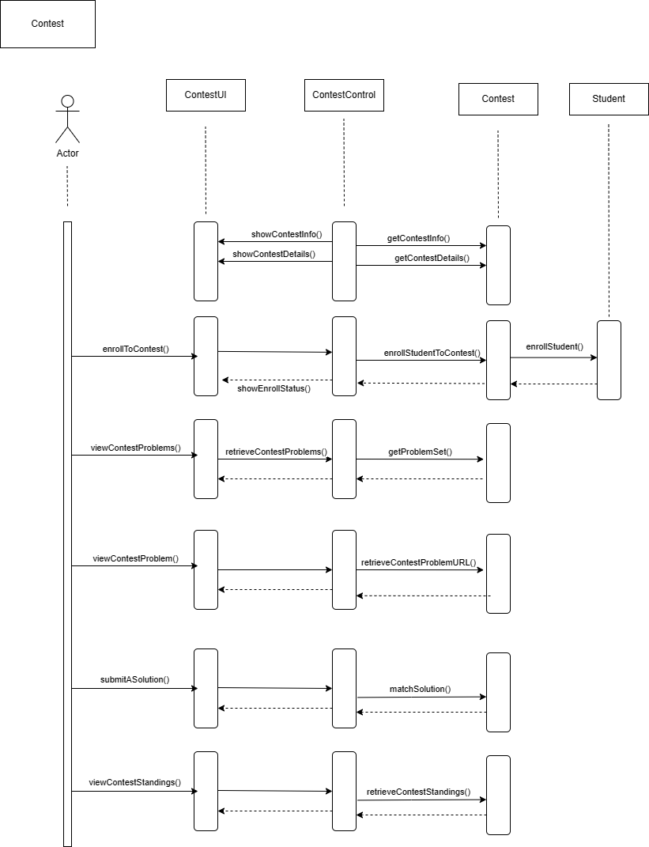
Contest and Daily Quiz:

Slide 12
Collaboration
Diagram

Slide 13
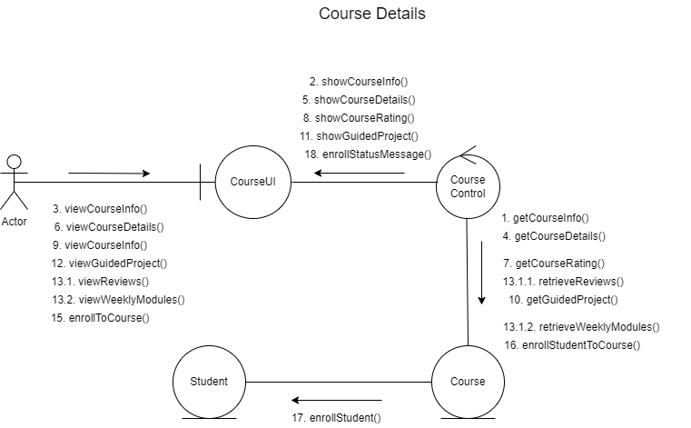
Course Details Page:

Slide 14
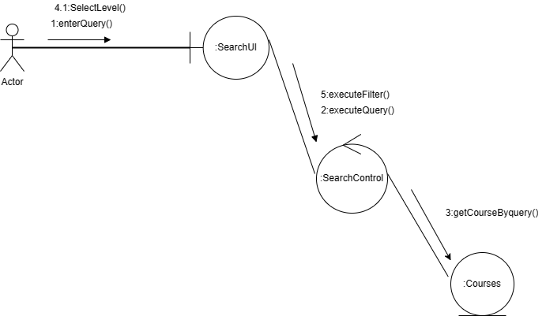
Course Searching:

Slide 15
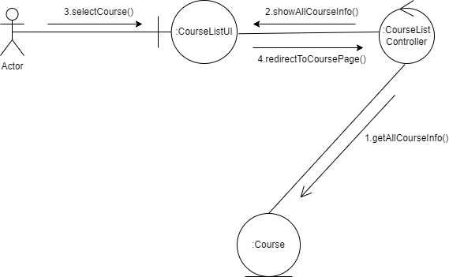
User DashBoard (HomePage):

Slide 16
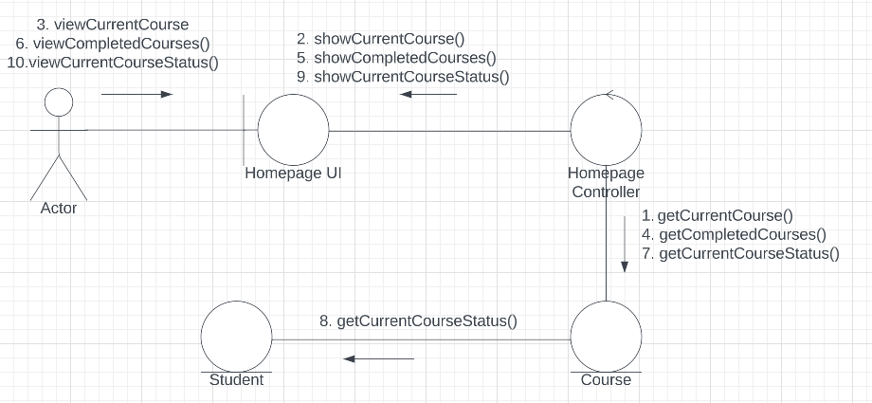
User DashBoard 2 (HomePage):

Slide 17
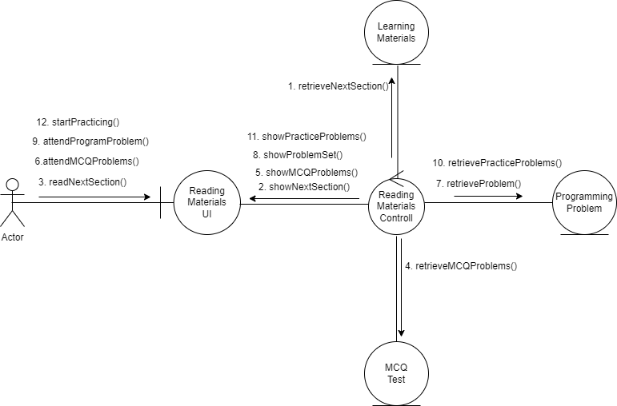
Reading_Materials:

Slide 18
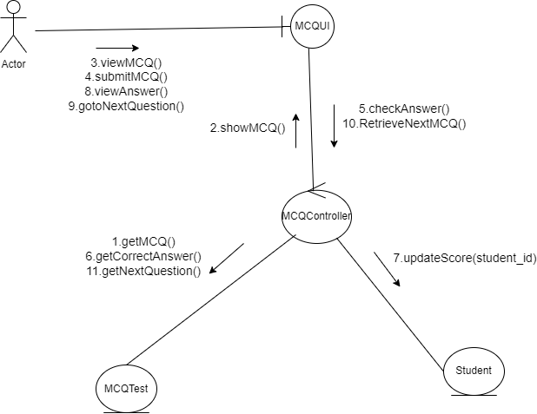
MCQ_Test:

Slide 19
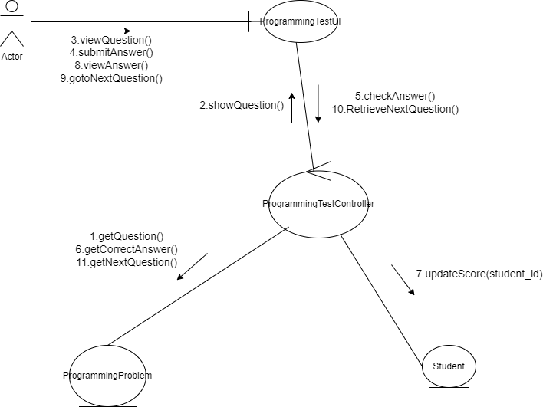
Programming_Problem_Test:

Slide 20
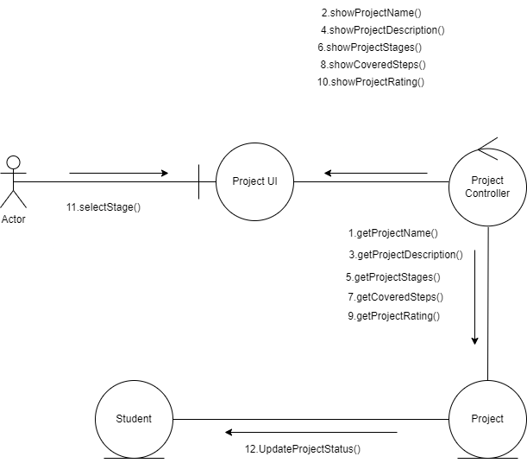
Project:

Slide 21
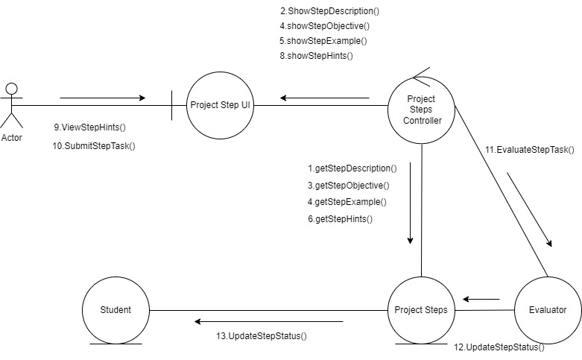
Project Steps:

Slide 22
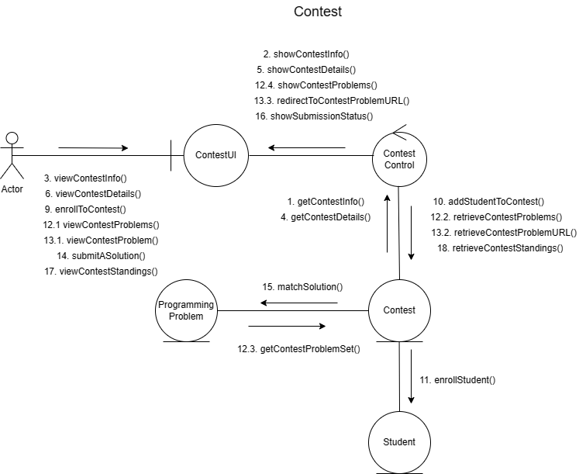
Contest and Daily Quiz:

